Slide 1

Course Code : M23DE0106 Course Title: Python Programming Academic Year & Semester:2024-2025(Odd Semester)​ Class: I MCA -A Name of the Faculty: Md Abdul Kader Jailani School of Computer Science & Applications
Unit-2

Slide 2
USING NUMPY&PANDAS
UNIT - II

Slide 3
UNIT II
UNIT II : USING NUMPY & PANDAS 13 Hours
Basics of NumPy-Computation on NumPy-Aggregations-Computation onArrays-Comparisons, Masks and Boolean Arrays-Fancy Indexing-Sorting Arrays-Structured Data: NumPy’s Structured Array
Introduction to Pandas Data in Pandas-Handling Missing Data-Hierarchical Indexing-Combining Data Sets.

Slide 4
Array – python
Using array module
Using numpy module

Slide 5
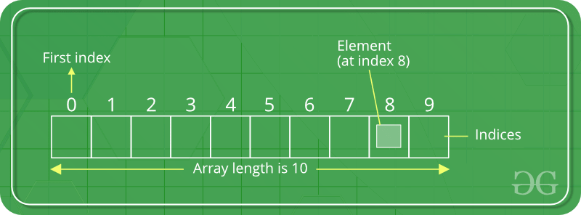
Array in Python
An array is a collection of items stored at contiguous memory locations. The idea is to store multiple items of the same type together.
Array in Python can be created by importing an array module.
array(data_type, value_list) is used to create array in Python with data type and value list specified in its arguments.
Create an Array in Python

Slide 6
Array Module - Display elements & length of an array
import array as arr
>>> a=arr.array('i',[11,22,33])
>>> a
array('i', [11, 22, 33])
>>> len(a)
3
>>>type(a)
<class 'array.array'>
Printing the index of array elements
for i in range(0,3):
print(i)
0
1
2
Printing the array elements
for i in range(0,3):
print(a[i])
11
22
33

Slide 7
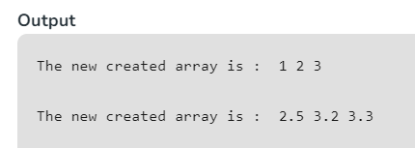
In below code Python create array : one of integers and one of doubles. It then prints the contents of each array to the console.
import array as arr
a = arr.array('i', [1, 2, 3])
print("The new created array is : ", end=" ")
for i in range(0, 3):
print(a[i], end=" ")
print()
b = arr.array('d', [2.5, 3.2, 3.3])
print("\nThe new created array is : ", end=" ")
for i in range(0, 3):
print(b[i], end=" ")

Slide 8
Array Module - sort
import array as arr
p = arr.array('i', [2, 1, 4, 7, 6, 3])
print(sorted(p)) # Prints the sorted array in ascending order
# Output: [1, 2, 3, 4, 6, 7]
sorted_p_reverse = sorted(p, reverse=True)
print(sorted_p_reverse) # Prints the sorted array in descending order
# Output: [7, 6, 4, 3, 2, 1]
a=arr.array('i',[11,22])
a.insert(2,33)
>>>a
array('i', [11, 22, 33])
a[3:5]=arr.array('i',[44,55])
a
array('i', [11, 22, 33, 44, 55])
a[2:5]=arr.array('i',[1,2,3])
>>>a
array('i', [11, 22, 1, 2, 3])
del a[2]
>>>a
array(‘i', [11,22,2,3])
>>>del a
>>> a
Error

Slide 9
Array Module - Append and extend array
import array as ar
>>> a=ar.array('i',[11,22,33])
>>> a.append(55)
>>> a
array('i', [11, 22, 33, 55])
a.extend([1,11,111])
>>> a
array('i', [11, 22, 33, 55, 1, 11, 111])

Slide 10
Array Module - Traverse array
import array as arr
>>> a=arr.array('i',[11,22,33])
>>> a
array('i', [11, 22, 33])
>>> len(a)
3
Printing the reverse
a.reverse()
>>> a
array('i', [33,22,11])
Printing the array elements
for i in range(0,3):
print(a[i])
33
22
11

Slide 11
Array Module - search
import array as ar
a=ar.array('i',[11,22,33])
f=0
key = int(input('enter key to search'))
for i in range(0,3):
if key==a[i]:
f=1
break
if f==1:
print('element found at {0}'.format(i+1))
else:
print('element not found')
enter key to search5
element not found
enter key to search22
element found at 2

Slide 12
Array Module - search
import array as ar
a=ar.array('i',[11,22,33])
key = int(input('enter key to search'))
if key in a:
print('element found‘, a.index(key)))
else:
print('element not found')
enter key to search5
element not found
enter key to search22
element found 1

Slide 13
Create an array of integers named a with elements [1, 2, 3]. In below code Python print array as array is printed before and after inserting the integer 4 at index 1. Similarly, an array of doubles named b with elements [2.5, 3.2, 3.3] is created and printed before and after appending the double 4.4 to the array.
import array as arr
a = arr.array('i', [1, 2, 3])
print("Array before insertion : ", end=" ")
for i in range(0, 3):
print(a[i], end=" ")
print()
a.insert(1, 4)
print("Array after insertion : ", end=" ")

Slide 14
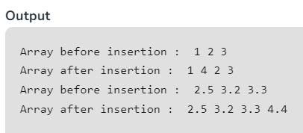
for i in (a):
print(i, end=" ")
print()
b = arr.array('d', [2.5, 3.2, 3.3])
print("Array before insertion : ", end=" ")
for i in range(0, 3):
print(b[i], end=" ")
print()
b.append(4.4)
print("Array after insertion : ", end=" ")
for i in (b):
print(i, end=" ")
print()

Slide 15
USING NUMPY
Basics of NumPy
NumPy is a Python library.
NumPy is used for working with arrays.
NumPy is short for "Numerical Python".
What is NumPy?
NumPy is a Python library used for working with arrays.
It also has functions for working in domain of linear algebra, fourier transform, and matrices.
NumPy was created in 2005 by Travis Oliphant. It is an open source project and you can use it freely.
NumPy stands for Numerical Python.

Slide 16
Data manipulation in Python is nearly synonymous with NumPy array manipulation: even newer tools like Pandas are built around the NumPy array.
Presents using NumPy array manipulation to access data and subarrays, and to split, reshape, and join the arrays.
They comprise the building blocks of many other data types.

Slide 17
USING NUMPY
Why Use NumPy?
In Python we have lists that serve the purpose of arrays, but they are slow to process.
NumPy aims to provide an array object that is up to 50x faster than traditional Python lists.
The array object in NumPy is called ndarray, it provides a lot of supporting functions that make working with ndarray very easy.
Arrays are very frequently used in data science, where speed and resources are very important.
Which Language is NumPy written in?
NumPy is a Python library and is written partially in Python, but most of the parts that require fast computation are written in C or C++.

Slide 18
USING NUMPY
Why is NumPy Faster Than Lists?
NumPy arrays are stored in contiguous memory blocks, which allows for efficient memory access and better utilization of CPU cache.
This is the main reason why NumPy is faster than lists. Also it is optimized to work with latest CPU architectures.
NumPy operations are implemented in highly optimized C and Fortran code. These low-level implementations are much faster than the equivalent operations performed in pure Python.
NumPy can leverage multi-core CPUs and parallel processing libraries like Intel's MKL to further accelerate computations.
NumPy provides a wide range of optimized algorithms for common mathematical operations, such as linear algebra, Fourier transforms, random number generation, etc., which are typically much faster than their Python equivalents.

Slide 19
Discuss the advantages of using NumPy arrays over Python lists.
Using NumPy arrays over Python lists offers several advantages, especially for numerical computing and data manipulation tasks. Here are some of the key advantages:
Performance:
NumPy arrays are implemented in C, which makes them much faster and more efficient than Python lists, especially for large datasets.
NumPy arrays use contiguous blocks of memory, allowing for efficient memory access and vectorized operations.
NumPy operations are optimized for speed, making them well-suited for numerical computations.
Ease of use:
NumPy provides a wide range of built-in functions and methods for array manipulation, mathematical operations, linear algebra, and statistics.
NumPy syntax is concise and intuitive, making it easier to write and understand code compared to nested loops with Python lists.

Slide 20
3. Broadcasting:
NumPy arrays support broadcasting, which allows you to perform arithmetic operations between arrays of different shapes.
Broadcasting automatically aligns arrays with compatible shapes, eliminating the need for explicit looping or reshaping.
4. Memory efficiency:
NumPy arrays require less memory compared to Python lists, especially when dealing with large datasets.
NumPy arrays store data in a contiguous block of memory, whereas Python lists store references to objects, leading to higher memory overhead.
5. Parallelism:
NumPy operations can take advantage of parallelism and multi-threading, especially on systems with multiple cores or CPUs.
NumPy allows you to utilize parallel computing libraries like Intel MKL, OpenBLAS, or CUDA for GPU acceleration, further improving performance.

Slide 21
6. Interoperability:
NumPy arrays can be easily integrated with other scientific computing libraries and tools in the Python ecosystem, such as SciPy, pandas, matplotlib, and scikit-learn.
Many libraries and frameworks in data science and machine learning rely on NumPy arrays as their primary data structure, ensuring compatibility and interoperability.
Overall, NumPy arrays provide a powerful and efficient way to work with numerical data in Python, offering performance benefits, ease of use, and extensive functionality for numerical computing tasks.

Slide 22
USING NUMPY
Installation of NumPy
If you have Python and PIP already installed on a system, then installation of NumPy is very easy.
Install it using this command:
>C:\Users\Your Name>pip install numpy
Import NumPy
Once NumPy is installed, import it in your applications by adding the import keyword:
>import numpy

Slide 23
Arrays and NUMPY Arrays in Python
Arrays:
In Python, arrays are provided by the built-in array module.
Arrays in Python are a collection of elements of the same data type stored at contiguous memory locations.
Arrays in Python are one-dimensional and can only contain elements of a single data type.
Arrays in Python have limited functionality compared to NumPy arrays.
Arrays in Python are generally less used than NumPy arrays due to their limited functionality.

Slide 24
NumPy arrays:
NumPy (Numerical Python) is a powerful library in Python used for numerical computing.
NumPy arrays, or ndarray, are a fundamental data structure in NumPy.
NumPy arrays are multidimensional arrays that can hold elements of different data types.
NumPy arrays support a wide range of mathematical operations and functions optimized for numerical computations.
NumPy arrays offer extensive functionality and are widely used in scientific computing, data analysis, and machine learning.
While both arrays and NumPy arrays serve the purpose of storing collections of elements, NumPy arrays offer much more functionality, flexibility, and performance compared to the built-in arrays provided by Python's array module. Therefore, NumPy arrays are preferred for most numerical computing tasks in Python.

Slide 25
Basics of Numpy Arrays
Creation of arrays
Attributes of arrays : Determining the size, shape, memory consumption, and data types of arrays
Indexing of arrays: Getting and setting the value of individual array elements
Slicing of arrays: Getting and setting smaller subarrays within a larger array
Reshaping of arrays: Changing the shape of a given array
Joining and splitting of arrays : Combining multiple arrays into one, and splitting one array into many

Slide 26
Creation of NumPy Array
NumPy is used to work with arrays.
The array object in NumPy is called ndarray.
create a NumPy ndarray object by using the array() function.
Example
import numpy
a = numpy.array([1, 2, 3, 4, 5])
print(a)
type(a)
Output: array([1, 2, 3, 4, 5])
<class 'numpy.ndarray'>

Slide 27
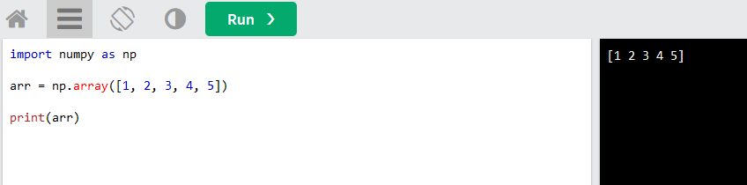
USING NUMPY
NumPy as np
NumPy is usually imported under the np alias.
Create an alias with the as keyword while importing:
Example
import numpy as np
arr = np.array([1, 2, 3, 4, 5])
print(arr)
OUTPUT

Slide 28
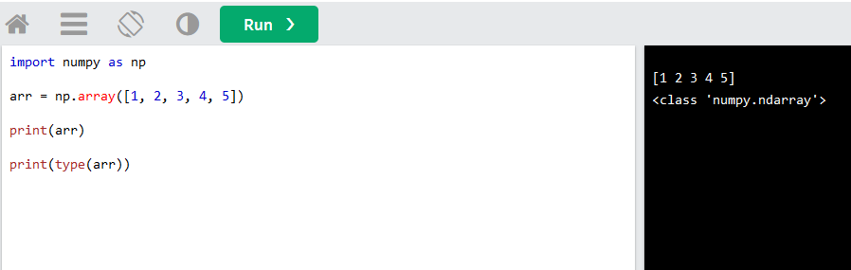
Computation on NumPy Array
NumPy Creating Arrays
NumPy is used to work with arrays. The array object in NumPy is called ndarray.
We can create a NumPy ndarray object by using the array() function.
Example OUPUT
import numpy as np arr = np.array([1, 2, 3, 4, 5]) print(arr) print(type(arr))

Slide 29
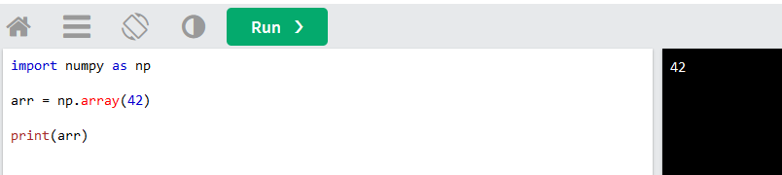
Computation on NumPy Array
Dimensions in Arrays
A dimension in arrays is one level of array depth (nested arrays).
nested array: are arrays that have arrays as their elements.
0-D Arrays
0-D arrays, or Scalars, are the elements in an array. Each value in an array is a 0-D array.
Example :Create a 0-D array with value 42
import numpy as np arr = np.array(42) print(arr)

Slide 30
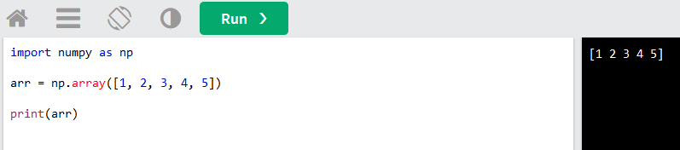
Computation on NumPy Array
1-D Arrays
An array that has 0-D arrays as its elements is called uni-dimensional or 1-D array.
These are the most common and basic arrays.
Example
Create a 1-D array containing the values 1,2,3,4,5:
import numpy as np arr = np.array([1, 2, 3, 4, 5]) print(arr)

Slide 31
Creation of NumPy Array
np.zeros(4, dtype=int)
Output: array([0, 0, 0, 0])
np.ones(5, dtype=int)
Output: array([1, 1, 1, 1, 1])
np.full(3,’*’)
Output: array(['*', '*', '*'], dtype='<U1')
One Dimensional Array:
import numpy as np
a = np.array([1, 2, 3, 4, 5])
print(a)
a=np.array((range(1,6)))
print(a)
a= np.arange(1,6)
print(a)
OUTPUT:
[1 2 3 4 5]
[1 2 3 4 5]
[1 2 3 4 5]

Slide 32
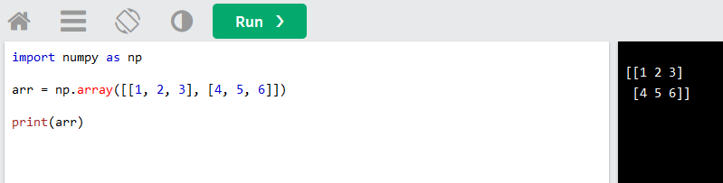
Computation on NumPy Array
2-D Arrays
An array that has 1-D arrays as its elements is called a 2-D array.
These are often used to represent matrix or 2nd order tensors.
NumPy has a whole sub module dedicated towards matrix operations called numpy.mat
Example
Create a 2-D array containing two arrays with the values 1,2,3 and 4,5,6:
import numpy as np arr = np.array([[1, 2, 3], [4, 5, 6]]) print(arr)

Slide 33
Creation of NumPy Array
Two-Dimensional Array:;
import numpy as np
a = np.array([[1, 2, 3, 4],[11,22,33,44])
print(a)
OUTPUT: array([[ 1, 2, 3, 4],
[11, 22, 33, 44]])
np.zeros((2,2),dtype=int)
Output: array([[0, 0],
[0, 0]])
import numpy as np
np.array([range(i, i + 3) for i in [2, 4, 6]])
OUTPUT: array([[2, 3, 4],
[4, 5, 6],
[6, 7, 8]])
np.ones((3, 3))
Output: array([[ 1, 1, 1],
[ 1, 1, 1],
[ 1, 1, 1]])

Slide 34
Creation of NumPy Array
n.full((2, 2), "MSc")
Output: array([['MSc', 'MSc'],
[‘MSc', 'MSc']],
dtype='<U3')
n.full((2, 2), 100)
Output: array([[100, 100],
[100, 100]])
n.random.randint(0, 10, (2,3))
array([[2, 1, 0],
[0, 2, 9]])
n.random.normal(0, 1, (2,2))
Output:
array([[ 1.63193523, 2.03583341],
[-1.72909427, 0.44782316]])
n.random.random((2, 2))
Output:
array([[0.94788161, 0.80725669],
[0.5807164 , 0.26950806]])

Slide 35
Creation of NumPy Array
np.eye(3,dtype=int)
array([[1, 0, 0],
[0, 1, 0],
[0, 0, 1]])
np.empty(3) #Create an uninitialized array of three integers
array([ 1., 1., 1.])

Slide 36
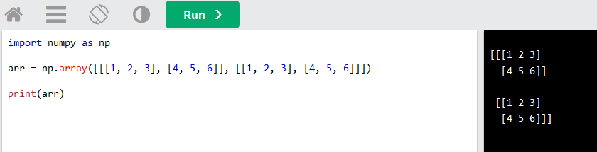
Computation on NumPy Array
3-D arrays
An array that has 2-D arrays (matrices) as its elements is called 3-D array.
These are often used to represent a 3rd order tensor.
Example :Create a 3-D array with two 2-D arrays, both containing two arrays with the values 1,2,3 and 4,5,6:
import numpy as np arr = np.array([[[1, 2, 3], [4, 5, 6]], [[1, 2, 3], [4, 5, 6]]]) print(arr)

Slide 37
Which libraries are required to be installed to work with an array in python? Discuss how do we import those libraries.
To work with arrays in Python, you generally don't need to install any additional libraries if you're using the built-in array module. The array module is part of Python's standard library, so it comes pre-installed with Python itself.
However, if you want to work with more advanced array operations, particularly for numerical computing and data manipulation, you might want to consider using the NumPy library (numpy). NumPy offers a wide range of functionalities for working with arrays and is extensively used in scientific computing, data analysis, and machine learning.
If you choose to use NumPy, you need to install it using a package manager like pip. You can install NumPy by running the following command in your terminal or command prompt:
pip install numpy
Once installed, you can import NumPy in your Python scripts or interactive sessions using:
import numpy as np

Slide 38
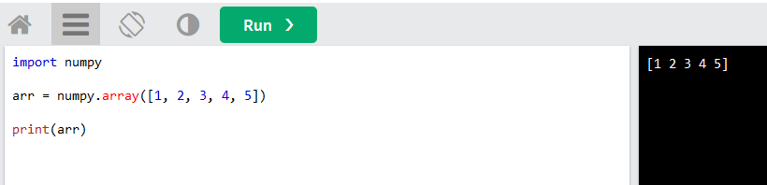
USING NUMPY
Example
import numpy
arr = numpy.array([1, 2, 3, 4, 5])
print(arr)
OUTPUT

Slide 39
Different types of arrays in Python using both the built-in array module .
import array
# Creating an array of integers
int_array = array.array('i', [1, 2, 3, 4, 5])
# Creating an array of characters
char_array = array.array('u', ['a', 'b', 'c'])
# Creating an array of floats
float_array = array.array('d', [3.14, 2.718, 1.618])
# Creating an array of bytes
byte_array = array.array('B', [65, 66, 67]) # ASCII values of 'A', 'B', 'C'

Slide 40
Different types of arrays in Python using NumPy library
import numpy as np a = np.array(42) b = np.array([1, 2, 3, 4, 5]) c = np.array([[1, 2, 3], [4, 5, 6]]) d = np.array([[[1, 2, 3], [4, 5, 6]], [[1, 2, 3], [4, 5, 6]]]) print(a.ndim) print(b.ndim) print(c.ndim) print(d.ndim)

Slide 41
Attributes of arrays
NumPy Arrays has the following attributes:
ndim (returns an integer that tells us how many dimensions the array have - the number of dimensions).
shape (the size of each dimension),
size (the total size of the array):
itemsize, which lists the size (in bytes) of each array element.
nbytes, which lists the total size (in bytes) of the array

Slide 42
Attributes of arrays
Output:
x1,x2,x3 dimensions: 1 2 3
x1,x2,x3 shape: (3,) (3,3) (2, 3, 4)
x1,x2,x3 size: 3 9 24
x1=array( [1,4,7])
x2= array([[1., 1., 1.],
[1., 1., 1.],
[1., 1., 1.]])
x3= array([[ [5 2 8 8]
[5 8 7 4]
[4 1 0 9]]
[[5 3 1 4]
[4 1 5 0]
[1 7 1 0]]] )
import numpy as np
x1 = np.arange(1,10, 3)
x2 = np.ones((3, 3))
x3 = np.random.randint(10, size=(2, 3, 4))
print('x1,x2,x3 dimensions:',x1.ndim,x2.ndim,x3.ndim)
print('x1,x2,x3 shape:',x1.shape,x2.shape,x3.shape)
print('x1,x2,x3 size:',x1.size,x2.size,x3.size)
print('x1=',x1)
print('x2=',x2)
print('x3=',x3)

Slide 43
Attributes of arrays
print("dtype:", x1.dtype,x2.dtype,x3.dtype)
print("itemsize:", x1.itemsize, "bytes")
print("nbytes:", x1.nbytes, "bytes")
Output:
dtype: int32 float64 int32
itemsize: 4 bytes 8 bytes 4 bytes
nbytes: 12 bytes 72 bytes 96 bytes

Slide 44
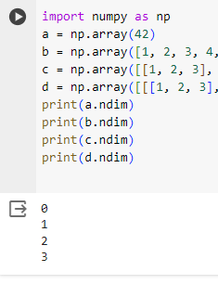
Check Number of Dimensions?
NumPy Arrays provides the ndim attribute that returns an integer that tells us how many dimensions the array have.
Example :Check how many dimensions the arrays have: OUTPUT
import numpy as np a = np.array(42) b = np.array([1, 2, 3, 4, 5]) c = np.array([[1, 2, 3], [4, 5, 6]]) d = np.array([[[1, 2, 3], [4, 5, 6]], [[1, 2, 3], [4, 5, 6]]]) print(a.ndim) print(b.ndim) print(c.ndim) print(d.ndim)

Slide 45
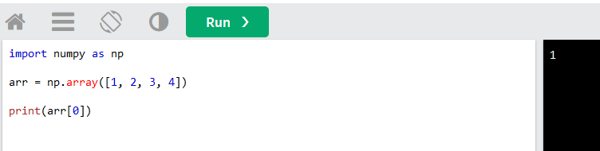
Basics of Numpy Arrays : Indexing
Access Array Elements
Array indexing is the same as accessing an array element.
You can access an array element by referring to its index number.
The indexes in NumPy arrays start with 0, meaning that the first element has index 0, and the second has index 1 etc.
Example
Get the first element from the following array:
import numpy as np arr = np.array([1, 2, 3, 4]) print(arr[0])

Slide 46
Basics of Numpy Arrays : Indexing
x1 = np.array([8,1,2,7])
print(x1)
print(x1[0])
print(x1[-1])
[8 1 2 7]
8
7
print(x1[0])
print(x1)
x1[0]=2.44
print(x1)
8
[8 1 2 7]
[2 1 2 7]

Slide 47
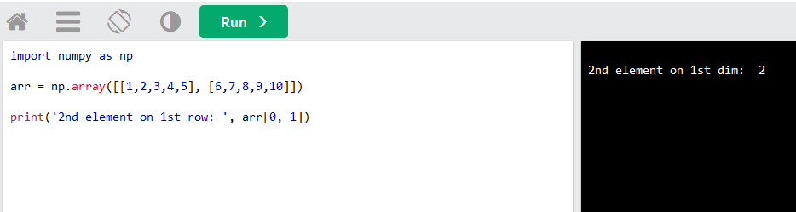
Computation on NumPy Array : NumPy Array Indexing
Access 2-D Arrays
To access elements from 2-D arrays we can use comma separated integers representing the dimension and the index of the element.
Think of 2-D arrays like a table with rows and columns, where the dimension represents the row and the index represents the column.
Example: Access the element on the first row, second column:
import numpy as np
arr = np.array([[1,2,3,4,5], [6,7,8,9,10]])
print('2nd element on 1st row: ', arr[0, 1])

Slide 48
Basics of Numpy Arrays : Indexing
x2 = np.array([[0,0], [2,0]])
print(x2)
print(x2[1,0])
print(x2[1,-1])
[[0 0]
[2 0]]
2
0
x2[1,-1]=100
x2
array([[ 0, 0],
[ 2, 100]])

Slide 49
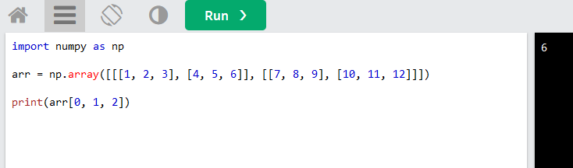
Computation on NumPy Array : NumPy Array Indexing
Access 3-D Arrays
To access elements from 3-D arrays we can use comma separated integers representing the dimensions and the index of the element.
Example
Access the third element of the second array of the first array:
import numpy as np arr = np.array([[[1, 2, 3], [4, 5, 6]], [[7, 8, 9], [10, 11, 12]]]) print(arr[0, 1, 2])
So arr[0, 1, 2] refers to the element in the first matrix (arr[0]),
second row ([1]), and third column ([2]).
[[[ 1 2 3]
[ 4 5 6]]
[[ 7 8 9]
[10 11 12]]]
print(a[0,0,0])
1
print(a[1,1,2])
12

Slide 50
Basics of Numpy Arrays: slicing
NumPy Array Slicing
Slicing in python means taking elements from one given index to another given index.
We pass slice instead of index like this: [start :end ].
We can also define the step, like this: [start :end :step].
If we don't pass start its considered 0
If we don't pass end its considered length of array in that dimension
If we don't pass step its considered 1

Slide 51
Basics of Numpy Arrays: slicing
x = np.arange(10)
print(x)
print(x[:5])
print(x[5:])
print(x[4:7])
print(x[::2])
print(x[1::2])
print(x[::-1])
print(x[5::-2]) # reversed every other from index 5
[0 1 2 3 4 5 6 7 8 9]
[0 1 2 3 4]
[5 6 7 8 9]
[4 5 6]
[0 2 4 6 8]
[1 3 5 7 9]
[9 8 7 6 5 4 3 2 1 0]
[5 3 1]

Slide 52
Basics of Numpy Arrays: slicing
Example
Slice elements from index 1 to index 5 from the following array:
Extract first 5 elements
Extract the last three
Reverse the array
Use negative indexing to extract the last but one element
Slice elements from index 4 to the end of the array
import numpy as np a = np.array([1, 2, 3, 4, 5, 6, 7])

Slide 53
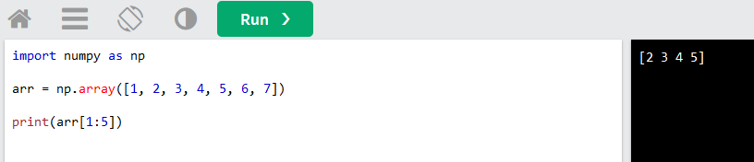
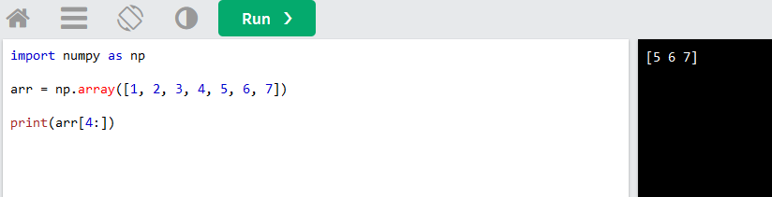
Computation on NumPy Array: NumPy Array Slicing
Example
Slice elements from index 1 to index 5 from the following array:
import numpy as np arr = np.array([1, 2, 3, 4, 5, 6, 7]) print(arr[1:5])
Example: Slice elements from index 4 to the end of the array:
import numpy as np
arr = np.array([1, 2, 3, 4, 5, 6, 7]
print(arr[4:])

Slide 54
Basics of Numpy Arrays: Reshaping of arrays
import numpy as np
arr = np.array([1, 2, 3, 4, 5, 6, 7, 8, 9, 10, 11, 12])
newarr = arr.reshape(4, 3)
print(newarr)
grid = np.arange(1, 10).reshape((3, 3))
print(grid)
[[1 2 3]
[4 5 6]
[7 8 9]]
x = np.array([1, 2, 3])
x[np.newaxis, :]
x.reshape((3, 1))
x[:,np.newaxis]
array([[1],
[2],
[3]])

Slide 55
Basics of Numpy Arrays: iterating arrays
Iterating means going through elements one by one.
To deal with multi-dimensional arrays in numpy, use for loop.
If iterate on a 1-D array it will go through each element one by one.
Example:Iterate on the elements of the following 1-D array:
import numpy as np
a = np.array([1, 2, 3])
for x in a: print(x)

Slide 56
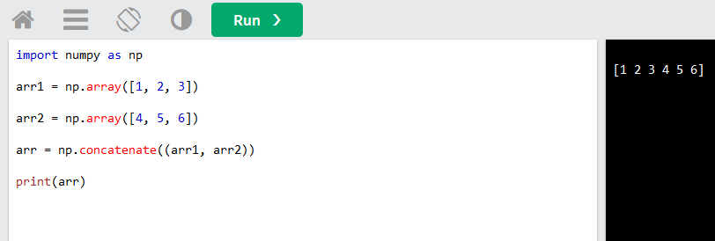
Basics of Numpy Arrays : Joining and splitting of arrays
NumPy Joining Array
Joining means putting contents of two or more arrays in a single array.
In SQL we join tables based on a key, whereas in NumPy we join arrays by axes.
We pass a sequence of arrays that we want to join to the concatenate() function, along with the axis. If axis is not explicitly passed, it is taken as 0.
Example
import numpy as np arr1 = np.array([1, 2, 3]) arr2 = np.array([4, 5, 6]) arr = np.concatenate((arr1, arr2)) print(arr)

Slide 57
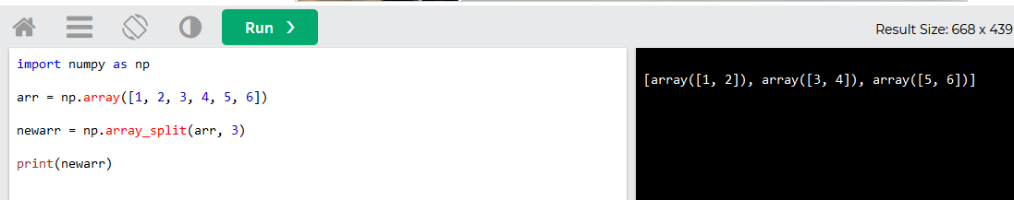
Basics of Numpy Arrays : Joining and splitting of arrays
Splitting NumPy Arrays
Splitting is reverse operation of Joining.
Joining merges multiple arrays into one and Splitting breaks one array into multiple.
We use array_split() for splitting arrays, we pass it the array we want to split and the number of splits.
Example
import numpy as np arr = np.array([1, 2, 3, 4, 5, 6]) newarr = np.array_split(arr, 3) print(newarr)

Slide 58
Basics of Numpy Arrays :Joining and splitting of arrays
u,l = np.vsplit(a, [3])
print(u)
print(l)
[[ 0 1 2 3] [ 4 5 6 7] [ 8 9 10 11]]
[[12 13 14 15]]
l, r = np.hsplit(a, [1])
print(l)
print(r)
[[ 0]
[ 4]
[ 8]
[12]]
[[ 1 2 3]
[ 5 6 7]
[ 9 10 11]
[13 14 15]]
x = [1, 2, 3, 99, 99, 3, 2, 1]
x1, x2, x3 = np.split(x, [2, 6])
print(x1, x2, x3)
[1 2] [ 3 99 99 3] [2 1]
a = np.arange(16).reshape((4, 4))
a
array([[ 0, 1, 2, 3],
[ 4, 5, 6, 7],
[ 8, 9, 10, 11],
[12, 13, 14, 15]])

Slide 59
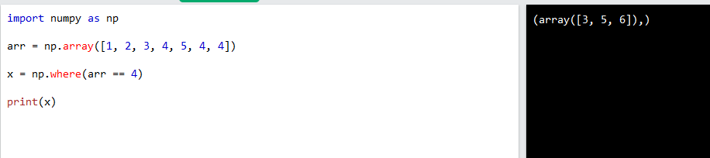
NumPy Searching Arrays
You can search an array for a certain value, and return the indexes that get a match.
To search an array, use the where() method.
Example
Find the indexes where the value is 4:
import numpy as np arr = np.array([1, 2, 3, 4, 5, 4, 4]) x = np.where(arr == 4) print(x)

Slide 60
Write a code to create a NumPy array and implement arithmetic and aggregate universal functions on it.
import numpy as np
# Create a NumPy array
np_array = np.array([1, 2, 3, 4, 5])
# Arithmetic operations using ufuncs
# Arrays for demonstration
a = np.array([1, 2, 3])
b = np.array([4, 5, 6])
# Addition
add_result = np.add(a, b)
print("Addition Result:", add_result)

Slide 61
# Subtraction
sub_result = np.subtract(a, b)
print("Subtraction Result:", sub_result)
# Multiplication
mul_result = np.multiply(a, b)
print("Multiplication Result:", mul_result)
# Division
div_result = np.divide(a, b)
print("Division Result:", div_result)
# Aggregate universal functions
sum_result = np.sum(np_array) # Sum of all elements
mean_result = np.mean(np_array) # Mean of all elements
max_result = np.max(np_array) # Maximum element
min_result = np.min(np_array) # Minimum element

Slide 62
print("Sum of array elements:", sum_result)
print("Mean of array elements:", mean_result)
print("Maximum element:", max_result)
print("Minimum element:", min_result)

Slide 63
Write a Python program to compute the matrix addition and transpose using iterative structure using NumPy array.
import numpy as np
# Function to compute matrix addition
def matrix_addition(matrix1, matrix2):
if matrix1.shape != matrix2.shape:
print("Error: Matrices must have the same shape for addition.")
return None
result = np.zeros(matrix1.shape)
for i in range(matrix1.shape[0]):
for j in range(matrix1.shape[1]):
result[i][j] = matrix1[i][j] + matrix2[i][j]
return result

Slide 64
# Function to compute matrix transpose
def matrix_transpose(matrix):
result = np.zeros((matrix.shape[1], matrix.shape[0]))
for i in range(matrix.shape[0]):
for j in range(matrix.shape[1]):
result[j][i] = matrix[i][j]
return result
# Example matrices
matrix1 = np.array([[1, 2, 3], [4, 5, 6]])
matrix2 = np.array([[7, 8, 9], [10, 11, 12]])

Slide 65
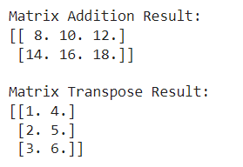
# Compute matrix addition
addition_result = matrix_addition(matrix1, matrix2)
print("Matrix Addition Result:")
print(addition_result)
# Compute matrix transpose
transpose_result = matrix_transpose(matrix1)
print("\nMatrix Transpose Result:")
print(transpose_result)

Slide 66
matrix1.shape[0] returns the number of rows in matrix1.
matrix1.shape[1] returns the number of columns in matrix1.
The line result = np.zeros((matrix.shape[1], matrix.shape[0])) creates a NumPy array filled with zeros, with dimensions transposed compared to the input matrix.

Slide 67
NumPy-Aggregations
NumPy aggregations refer to operations performed on arrays to summarize their values in some way, typically by computing a single scalar value from the elements of the array. These operations can include computing statistical measures such as the mean, median, minimum, maximum, standard deviation, variance, and more.
NumPy provides efficient built-in functions for performing these aggregations on arrays. These functions operate on entire arrays or along a specified axis, allowing for fast computation on large datasets.

Slide 68
Computation on NumPy Arrays: Universal Functions
Computation on NumPy arrays can be very fast, or it can be very slow, To make it fast, use vectorized operations, generally implemented through NumPy’s universal functions (ufuncs).
Python’s default implementation (known as CPython) does some operations very slowly due to types are flexible, so that sequences of operations cannot be compiled down to efficient machine code as in languages like C and Fortran.
Recently to address this weakness, few attempts like PyPy project-a just-in-time(JIT) compiled implementation of Python, the Cython project converts Python code to compilable C code and the Numba project converts snippets of Python code to fast LLVM(Low-Level Virtual Machine) bytecode.
The above three approaches are not surpassed the reach and popularity of the standard CPython engine.

Slide 69
Computation on NumPy Arrays: Universal Functions : Introducing Ufuncs:
For many types of operations, NumPy provides a convenient interface into just this kind of statically typed, compiled routine known as a vectorized operation.
This vectorized approach(This vectorized approach is designed to push the loop into the compiled layer that underlies NumPy, leading to much faster execution) is designed to push the loop into the compiled layer that underlies NumPy, leading to much faster execution.
Vectorized operations in NumPy are implemented via ufuncs, whose main purpose is to quickly execute repeated operations on values in NumPy arrays.
Ufuncs are extremely flexible and operations are not limited to one-dimensional arrays. (act on multidimensional arrays as well)
Computations using vectorization through ufuncs are nearly always more efficient than their counterpart implemented through Python loops, especially as the arrays grow in size.

Slide 70
Write short note on Numpy Universal functions.
NumPy Universal Functions (ufuncs) are functions that operate element-wise on NumPy arrays, allowing for efficient and vectorized computations. These functions are a key component of NumPy and play a crucial role in numerical computing and data manipulation tasks.
Element-wise operations: Ufuncs perform element-wise operations on NumPy arrays, meaning they apply the same operation to each element of the array independently. This allows for concise and efficient computation without the need for explicit looping over array elements.
Vectorized computation: Ufuncs are implemented in compiled C code, which makes them highly efficient and fast compared to equivalent operations performed using Python loops. They take advantage of optimized algorithms and CPU-specific optimizations to achieve high performance.

Slide 71
3. Support for arithmetic operations: NumPy ufuncs support a wide range of arithmetic operations, including addition, subtraction, multiplication, division, exponentiation, and more. These operations can be applied to arrays of any shape and size, including multi-dimensional arrays.
4. Trigonometric functions: NumPy ufuncs include trigonometric functions such as sine, cosine, tangent, arcsine, arccosine, and arctangent. These functions are useful for various mathematical and scientific computations involving angles and periodic phenomena.
5. Exponential and logarithmic functions: Ufuncs provide exponential and logarithmic functions such as exponentiation, natural logarithm, base 10 logarithm, and logarithm with any specified base. These functions are commonly used in mathematical and statistical computations.
6. Aggregation functions: In addition to element-wise operations, ufuncs include aggregation functions that compute summary statistics of array elements, such as sum, mean, standard deviation, variance, minimum, and maximum.

Slide 72
7. Broadcasting: Ufuncs support broadcasting, which allows them to operate on arrays of different shapes and sizes by automatically aligning array dimensions. This simplifies computation and eliminates the need for explicit array manipulation or reshaping.
Overall, NumPy Universal Functions provide a powerful and efficient way to perform element-wise computations on NumPy arrays, enabling concise, vectorized, and high-performance numerical computing in Python. They are essential tools for data scientists, engineers, and researchers working with numerical data and scientific computing applications.

Slide 73
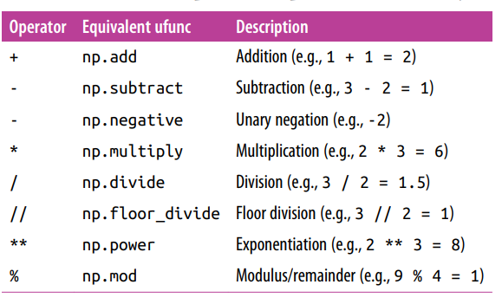
Computation on NumPy Arrays: UFunc – 1. Arithmetic
Ufuncs exist in two flavors: unary ufuncs(operate on a single operand/input), and binary ufuncs (operate on two operands/inputs).
Array arithmetic : NumPy’s ufuncs feel very natural to use because they make use of Python’s native arithmetic operators - addition, subtraction, multiplication, and division.
x = np.arange(4)
print("x =", x)
print("x + 5 =", x + 5)
print("x - 5 =", x - 5)
print("x * 2 =", x * 2)
print("x / 2 =", x / 2)
print("x // 2 =", x // 2)

Slide 74
Computation on NumPy Arrays: UFunc – 1. Arithmetic
a unary ufunc for negation,
** operator for exponentiation, and
% operator for modulus
x=[0,1, 2, 3]
print("-x = ", -x) -------- > -x = [ 0 -1 -2 -3]
print("x ** 2 = ", x ** 2) -------→ x ** 2 = [0 1 4 9]
print("x % 2 = ", x % 2) ----→ x % 2 = [0 1 0 1]
-(0.5*x + 1) ** 2 -------→ array([-1. , -2.25, -4. , -6.25])

Slide 75
UFunc – 1. Arithmetic-contd..
Program demonstrating various arithmetic operations using NumPy's universal functions:
import numpy as np
# Arrays for demonstration
a = np.array([1, 2, 3])
b = np.array([4, 5, 6])
# Addition
add_result = np.add(a, b)
print("Addition Result:", add_result)

Slide 76
UFunc – 1. Arithmetic-contd..
# Subtraction
sub_result = np.subtract(a, b)
print("Subtraction Result:", sub_result)
# Multiplication
mul_result = np.multiply(a, b)
print("Multiplication Result:", mul_result)

Slide 77
UFunc – 1. Arithmetic-contd..
# Division
div_result = np.divide(a, b)
print("Division Result:", div_result)
# Exponentiation
exp_result = np.power(a, b)
print("Exponentiation Result:", exp_result)
This program imports NumPy, creates two arrays a and b, and then performs addition, subtraction, multiplication, division, and exponentiation using NumPy's universal functions (np.add(), np.subtract(), np.multiply(), np.divide(), and np.power() respectively). Finally, it prints out the results of each operation.
Output:
Addition Result: [5 7 9]
Subtraction Result: [-3 -3 -3] Multiplication Result: [ 4 10 18]
Division Result: [0.25 0.4 0.5 ] Exponentiation Result: [ 1 32 729]

Slide 78
Computation on NumPy Arrays: UFunc – 1. Arithmetic
All of these arithmetic operations are simply convenient wrappers around specific functions built into NumPy;
Example, the + operator is a wrapper for the add function:
import numpy as np
x=np.array([0,1,2,3])
print(np.add(x, 2))
Output:
[2 3 4 5]

Slide 79
Computation on NumPy Arrays: UFunc – 2. Absolute
NumPy arrays, performing the same operation on each element in the array. np.absolute() is one such ufunc that computes the absolute value of each element in the input array. It is often abbreviated as np.abs().
Example:
import numpy as np
# Creating an array with both positive and negative values
arr = np.array([-1, 2, -3, 4, -5])
# Computing the absolute values of the elements in the array
abs_arr = np.absolute(arr)
print(abs_arr)
Output: [1 2 3 4 5]

Slide 80
UFunc – 2. Absolute contd..
ufunc can also handle complex data, When dealing with complex numbers, the np.absolute() function (or np.abs()) returns the magnitude (or absolute value) of each complex number. The magnitude of a complex number a + bj is given by sqrt(a^2 + b^2).
Example:
import numpy as np
# Creating an array with complex numbers
complex_arr = np.array([1 + 2j, -3 - 4j, 5 + 12j])
# Computing the absolute values (magnitudes) of the complex numbers
abs_complex_arr = np.absolute(complex_arr)
print(abs_complex_arr)
Output: [ 2.23606798 5. 13. ]

Slide 81
Computation on NumPy Arrays: UFunc – 3. Trigonometric
Trigonometric functions are also available as universal functions (ufuncs) in NumPy. They enable you to perform trigonometric operations element-wise on arrays. Here's how you can use some of the trigonometric ufuncs available in NumPy.
Trigonometric functions: NumPy provides a large number of useful ufuncs and the most useful for the data scientist are the trigonometric functions.
Example:
import numpy as np
# Array for demonstration
angles_degrees = np.array([0, 30, 45, 60, 90])

Slide 82
UFunc – 3. Trigonometric contd..
# Convert degrees to radians for trigonometric functions(The value of 180° is equal to π radians. To convert any given angle from the measure of degrees to radians, the value has to be multiplied by π/180, (1Deg × π/180 = 0.01745Rad)
angles_radians = np.radians(angles_degrees)
# Trigonometric functions
sin_values = np.sin(angles_radians)
cos_values = np.cos(angles_radians)
tan_values = np.tan(angles_radians)
# Print results
print("Angles (degrees):", angles_degrees)
print("Sine values:", sin_values)
print("Cosine values:", cos_values)
print("Tangent values:", tan_values)

Slide 83
UFunc – 3. Trigonometric contd..
Output:
Angles (degrees): [ 0 30 45 60 90]
Sine values: [0. 0.5 0.70710678 0.8660254 1. ]
Cosine values: [1.00000000e+00 8.66025404e-01 7.07106781e-01 5.00000000e-01 6.12323400e-17]
Tangent values: [0.00000000e+00 5.77350269e-01 1.00000000e+00 1.73205081e+00 1.63312394e+16]

Slide 84
Computation on NumPy Arrays: UFunc – 3. Trigonometric
Inverse trigonometric functions as given below:
NumPy provides inverse trigonometric functions, which enable you to compute the arcsine, arccosine, and arctangent of values, returning angles in radians. Here's how you can use these functions:

Slide 85
UFunc – 3. Trigonometric contd..
Example:
import numpy as np
# Values for demonstration
values = np.array([0, 0.5, 1])
# Compute inverse trigonometric functions
arcsin_values = np.arcsin(values)
arccos_values = np.arccos(values)
arctan_values = np.arctan(values)

Slide 86
UFunc – 3. Trigonometric contd..
# Convert angles from radians to degrees for easier interpretation
arcsin_degrees = np.degrees(arcsin_values)
arccos_degrees = np.degrees(arccos_values)
arctan_degrees = np.degrees(arctan_values)
# Print results
print("Values:", values)
print("Arcsine (radians):", arcsin_values)
print("Arcsine (degrees):", arcsin_degrees)
print("Arccosine (radians):", arccos_values)
print("Arccosine (degrees):", arccos_degrees)
print("Arctangent (radians):", arctan_values)
print("Arctangent (degrees):", arctan_degrees)

Slide 87
UFunc – 3. Trigonometric contd..
Output:
Values: [0. 0.5 1. ]
Arcsine (radians): [0. 0.52359878 1.57079633]
Arcsine (degrees): [ 0. 30. 90.]
Arccosine (radians): [1.57079633 1.04719755 0. ]
Arccosine (degrees): [90. 60. 0.]
Arctangent (radians): [0. 0.46364761 0.78539816]
Arctangent (degrees): [ 0. 26. 45.]

Slide 88
Computation on NumPy Arrays: UFunc – 4. Exponents and logarithms
Exponents: The common type of operation available in a NumPy ufunc are the exponentials
Logarithms: The inverse of the exponentials is the logarithms, are also available as natural logarithm; base-2 logarithm or the base-10 logarithm
Exponential Functions:
np.exp(x): Compute the exponential of each element in the array x.
np.exp2(x): Compute 2 raised to the power of each element in the array x.
np.expm1(x): Compute exp(x) - 1 [e^{x} - 1]for each element in the array x.

Slide 89
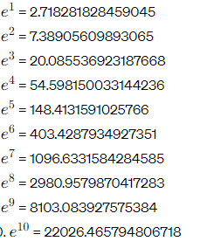
Exponential values of natural numbers from 1 to 10
import numpy as np
for i in range(1, 11):
print(np.exp(i))

Slide 90
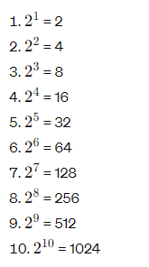
np.exp2(x): is a function provided by the NumPy library in Python. It calculates 2^{x} for each element in the input array x. This function is particularly useful when you want to compute exponentiation with a base of 2. It's similar to np.power(2, x), but np.exp2(x) may be more optimized for this specific operation.
import numpy as np
for i in range(1, 11):
result = np.exp2(i)
print(result)

Slide 91
UFunc – 4. Exponents and logarithms contd..
Logarithmic Functions:
np.log(x): Natural logarithm (base e) of each element in the array x.
np.log2(x): Base-2 logarithm of each element in the array x.
np.log10(x): Base-10 logarithm of each element in the array x.
np.log1p(x): Natural logarithm (base e) of 1 + x for each element in the array x.

Slide 92
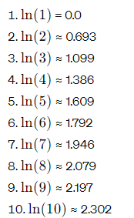
np.log(x) : is a function provided by the NumPy library in Python. It calculates the natural logarithm (base 𝑒) of each element in the input array x. In other words, it computes ln(𝑥) for each value of x. This function is commonly used in various mathematical and scientific computations.
import numpy as np
for i in range(1, 11):
result = np.log(i)
print(result)

Slide 93
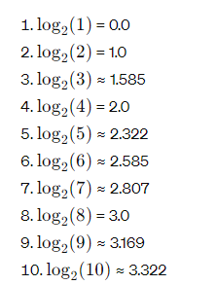
np.log2(x): is a function provided by the NumPy library in Python. It calculates the base-2 logarithm of each element in the input array x. In other words, it computes log 2(x) for each value of x. This function is useful when you want to transform data to a logarithmic scale with base 2, particularly in computer science and information theory contexts where base-2 logarithms are common.
import numpy as np
for i in range(1, 11):
result = np.log2(i)
print(result)

Slide 94
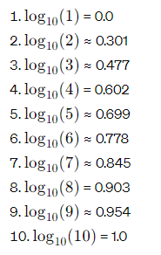
np.log10(x): is a function provided by the NumPy library in Python. It calculates the base-10 logarithm of each element in the input array x. In other words, it computes for each value of x. This function is commonly used when you want to transform data to a logarithmic scale, particularly for visualization or when dealing with orders of magnitude.
import numpy as np
for i in range(1, 11):
result = np.log10(i)
print(result)

Slide 95
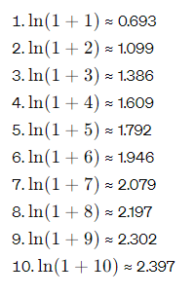
np.log1p(x): is a function provided by the NumPy library in Python. It calculates the natural logarithm of 1+x for each element in the input array x. In other words, it computes ln(1+x) for each value of x. This function is particularly useful when dealing with small values of x where directly computing ln(1+x) might result in loss of precision due to cancellation errors.
import numpy as np
for i in range(1, 11):
result = np.log1p(i)
print(result)

Slide 96
UFunc – 4. Exponents and logarithms contd..
Example:
import numpy as np
# Array for demonstration
x = np.array([1, 2, 3, 4, 5])
# Exponential functions
exp_values = np.exp(x)
exp2_values = np.exp2(x)
expm1_values = np.expm1(x)

Slide 97
UFunc – 4. Exponents and logarithms contd..
# Logarithmic functions
log_values = np.log(x)
log2_values = np.log2(x)
log10_values = np.log10(x)
log1p_values = np.log1p(x)
# Print results
print("Exponential (exp):", exp_values)
print("Exponential (exp2):", exp2_values)
print("Exponential (expm1):", expm1_values)
print("Logarithm (ln):", log_values)

Slide 98
UFunc – 4. Exponents and logarithms contd..
print("Logarithm (log2):", log2_values)
print("Logarithm (log10):", log10_values)
print("Logarithm (log1p):", log1p_values)
Output:
Exponential (exp): [ 2.71828183 7.3890561 20.08553692 54.59815003 148.4131591 ]
Exponential (exp2): [ 2. 4. 8. 16. 32.]
Exponential (expm1): [ 1.71828183 6.3890561 19.08553692 53.59815003 147.4131591 ]
Logarithm (ln): [0. 0.69314718 1.09861229 1.38629436 1.60943791]
Logarithm (log2): [0. 1. 1.5849625 2. 2.32192809]
Logarithm (log10): [0. 0.30103 0.47712125 0.60205999 0.69897 ]
Logarithm (log1p): [0.69314718 1.09861229 1.38629436 1.60943791 1.79175947]

Slide 99
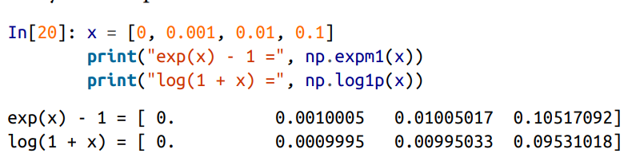
Computation on NumPy Arrays: UFunc – 4. Exponents and logarithms
There are also some specialized versions that are useful for maintaining precision with very small input:
When x is very small, these functions give more precise values than if the raw np.log or np.exp were used

Slide 100
Computation on NumPy Arrays: UFunc – 5. Advanced (Outer product)
Outer products: Finally, any ufunc can compute the output of all pairs of two different inputs using the outer method.
The outer product is a mathematical operation that takes two vectors and produces a matrix. This matrix represents the multiplication of each element of the first vector with each element of the second vector.
Here's a breakdown of how the outer product is computed:
Input: You start with two vectors, let's call them 𝑎 and 𝑏. If 𝑎a has 𝑚m elements and 𝑏 has 𝑛 elements, then the resulting outer product matrix will have dimensions 𝑚×𝑛.
Element-wise multiplication: For each element 𝑎𝑖​ in 𝑎 and each element 𝑏𝑗 in 𝑏, you multiply them together to form an element of the resulting matrix. This means that the element in the 𝑖-th row and 𝑗-th column of the resulting matrix will be 𝑎𝑖×𝑏𝑗.
Resulting matrix: After performing the element-wise multiplication for all combinations of elements from 𝑎 and 𝑏, you obtain the resulting matrix, where each element represents the product of a corresponding pair of elements from the two vectors.

Slide 101
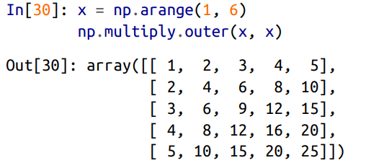
Computation on NumPy Arrays: UFunc – 5. Advanced (Outer product)
Create a multiplication table:

Slide 102
UFunc – 5. Advanced (Outer product) contd..
import numpy as np
# Define two arrays
a = np.array([1, 2, 3])
b = np.array([4, 5, 6])
# Compute the outer product using the ufunc outer
outer_product = np.outer(a, b)
print("Outer product:")
print(outer_product)
Output:
Outer product:
[[ 4 5 6]
[ 8 10 12]
[12 15 18]]

Slide 103
Computation on NumPy Arrays: UFunc – 5. Advanced (Aggregate)
Aggregates: For binary ufuncs, there are some interesting aggregates that can be computed directly from the object.
For example, to reduce an array with a particular operation, use the reduce method of any ufunc.
A reduce repeatedly applies a given operation to the elements of an array until only a single result remains.
For example, calling reduce on the add ufunc returns the sum of all elements in the array:
import numpy as np
x=np.arange(1,6)
s=np.add.reduce(x)
print(s)
15

Slide 104
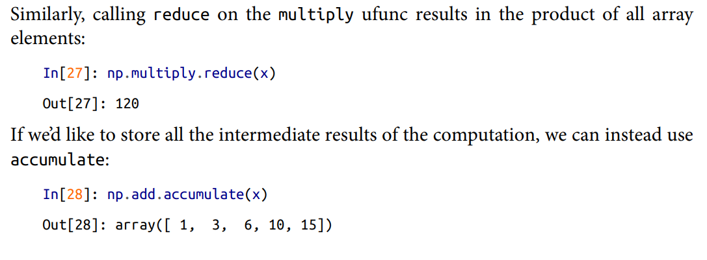
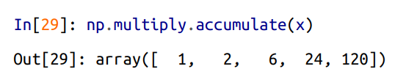
Computation on NumPy Arrays: UFunc – 5. Advanced (Aggregate)

Slide 105
Computation on NumPy Arrays: UFunc – 5. Advanced (Aggregate) : Aggregations: Min, Max, and Everything in Between
Large amount of data, a first step is to compute summary statistics for the data and the most common summary statistics are the mean and standard deviation, which allow you to summarize the “typical” values in a dataset.
Other aggregates are useful as well (the sum, product, median, minimum and maximum, quantiles, etc.).
NumPy has fast built-in aggregation functions for working on arrays.

Slide 106
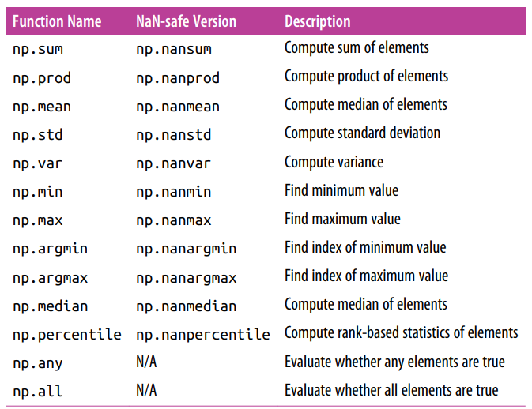
Aggregations: Min, Max, and Everything in Between
This percentile function is commonly used in statistical analysis and data processing to compute percentiles, which are measures used to describe the distribution of data.

Slide 107
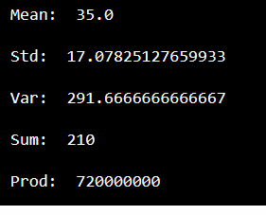
NumPy-Aggregations
import numpy as np
array1 = np.array([[10, 20, 30], [40, 50, 60]])
print("Mean: ", np.mean(array1))
print("Std: ", np.std(array1))
print("Var: ", np.var(array1))
print("Sum: ", np.sum(array1))
print("Prod: ", np.prod(array1))
OUTPUT

Slide 108
Aggregations: Min, Max, and Everything in Between
sum the values in an array using NumPy:
import numpy as np
# Define an array
arr = np.array([1, 2, 3, 4, 5])
# Sum the values in the array
total_sum = np.sum(arr)
print("Sum of array elements:", total_sum)
Output:
Sum of array elements: 15

Slide 109
Aggregations: Min, Max, and Everything in Between
Aggregations like finding the minimum, maximum, and various statistical measures for arrays are common tasks in data analysis and numerical computing. NumPy provides efficient functions for these operations.
import numpy as np
# Define an array
arr = np.array([2, 5, 1, 8, 3, 9, 4, 6, 7])
# Minimum value
min_value = np.min(arr)
print("Minimum value:", min_value)
# Maximum value
max_value = np.max(arr)
print("Maximum value:", max_value)

Slide 110
Aggregations: Min, Max, and Everything in Between
# Mean
mean_value = np.mean(arr)
print("Mean:", mean_value)
# Median
median_value = np.median(arr)
print("Median:", median_value)
# Standard deviation
std_dev = np.std(arr)
print("Standard Deviation:", std_dev)

Slide 111
Aggregations: Min, Max, and Everything in Between
# Variance
variance = np.var(arr)
print("Variance:", variance)
# Sum
total_sum = np.sum(arr)
print("Sum:", total_sum)
# Product of all elements
product = np.prod(arr)
print("Product:", product)

Slide 112
Aggregations: Min, Max, and Everything in Between
# Index of minimum value
min_index = np.argmin(arr)
print("Index of minimum value:", min_index)
# Index of maximum value
max_index = np.argmax(arr)
print("Index of maximum value:", max_index)

Slide 113
Aggregations: Min, Max, and Everything in Between
This code demonstrates various NumPy functions:
np.min() and np.max() find the minimum and maximum values in the array.
np.mean() calculates the mean (average) value of the array.
np.median() calculates the median value of the array.
np.std() computes the standard deviation of the array.
np.var() calculates the variance of the array.
np.sum() computes the sum of all elements in the array.
np.prod() calculates the product of all elements in the array.
np.argmin() and np.argmax() find the indices of the minimum and maximum values in the array, respectively.

Slide 114
Python program that generates a random NumPy array of size 2x3 filled with integers, computes its aggregate sum, minimum, and maximum values, and displays the results:
import numpy as np
# Generate a random 2x3 NumPy array filled with integers
random_array = np.random.randint(0, 100, size=(2, 3))
print("Random Array:")
print(random_array)

Slide 115
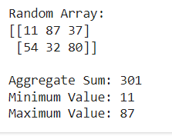
# Compute aggregate sum
array_sum = np.sum(random_array)
# Compute minimum value
array_min = np.min(random_array)
# Compute maximum value
array_max = np.max(random_array)
# Display the results
print("\nAggregate Sum:", array_sum)
print("Minimum Value:", array_min)
print("Maximum Value:", array_max)
OUTPUT:

Slide 116
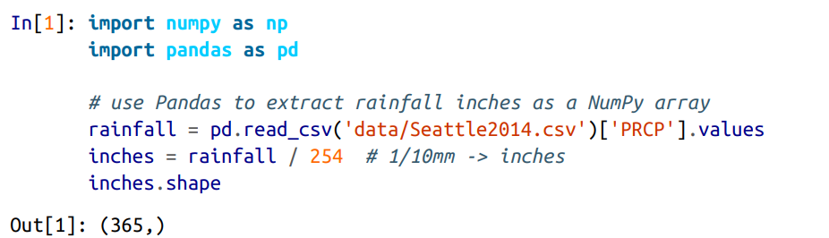
Comparisons, Masks, and Boolean Logic
Masking is to extract, modify, count, or otherwise manipulate values in an array based on some criterion. If to count all values greater than a certain value, or perhaps remove all outliers that are above some threshold, it can be used. In NumPy, Boolean masking is the most efficient way to accomplish these types of tasks.
Example: Counting Rainy Days I: Imagine a series of data represents the amount of precipitation each day for a year in a given city. Load the daily rainfall statistics for the city of Seattle in 2014, using Pandas. The array contains 365 values, giving daily rainfall in inches from January 1 to December 31, 2014.

Slide 117
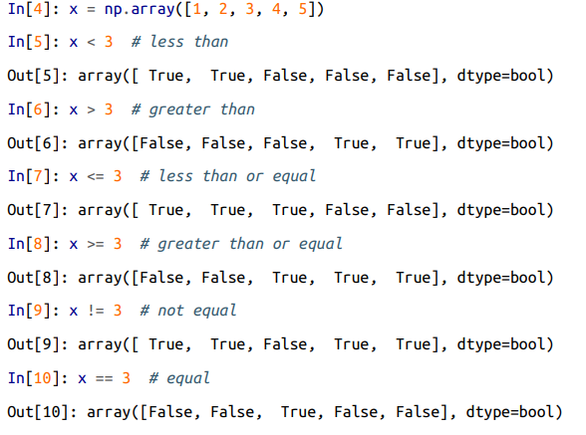
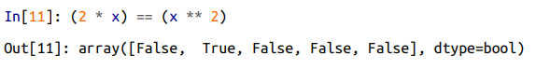
Comparisons, Masks, and Boolean Logic: Comparison Operators:
NumPy implements comparison operators such as < (less than) and > (greater than) as element-wise ufuncs.
The result of these comparison operators is always an array with a Boolean data type.
All six of the standard comparison operations are available;.
it is also possible to do an element-by-element comparison of two arrays, and to include compound expressions:

Slide 118
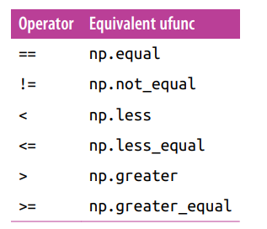
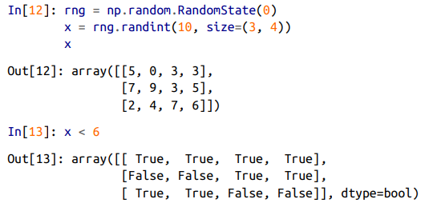
Comparisons, Masks, and Boolean Logic
As in the case of arithmetic operators, the comparison operators are implemented as ufuncs in NumPy; for example, x < 3, internally NumPy uses np.less(x, 3).
A summary of the comparison operators and their equivalent ufunc is shown here:
In each case, the result is a Boolean array, and NumPy provides a number of straight‐ forward patterns for working with these Boolean results.

Slide 119
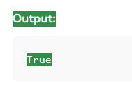
USING NUMPY Array COmparison
Comparing two NumPy arrays determines whether they are equivalent by checking if every element at each corresponding index is the same.
Method 1: We generally use the == operator to compare two NumPy arrays to generate a new array object.
import numpy as np
an_array = np.array([[1, 2], [3, 4]])
another_array = np.array([[1, 2], [3, 4]])
comparison = an_array == another_array
equal_arrays = comparison.all()
print(equal_arrays)

Slide 120
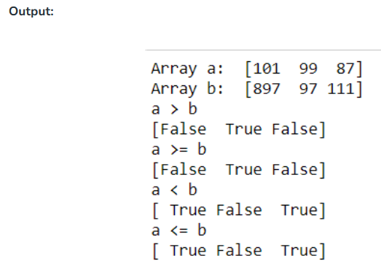
USING NUMPY:Array COmparison
print(np.greater(a, b))
print("a >= b")
print(np.greater_equal(a, b))
print("a < b")
print(np.less(a, b))
print("a <= b")
print(np.less_equal(a, b))
Method 2: We can also use greater than, less than and equal to operators to compare.
import numpy as np
a = np.array([101, 99, 87])
b = np.array([897, 97, 111])
print("Array a: ", a)
print("Array b: ", b)
print("a > b")

Slide 121
USING NUMPY:Array COmparison
Method 3: Using array_equal()
This array_equal() function checks if two arrays have the same elements and same shape.
Syntax:
numpy.array_equal(arr1, arr2)
import numpy as np
arr1 = np.array([[1, 2], [3, 4]])
arr2 = np.array([[1, 2], [3, 4]])
# Comparing the arrays
if np.array_equal(arr1, arr2):
print("Equal")
else:
print("Not Equal")

Slide 122
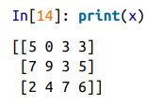
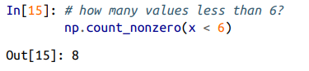
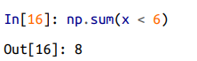
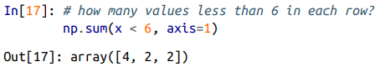
Comparisons, Masks, and Boolean Logic: Working with Boolean Arrays :
Given a Boolean array, there are a host of useful operations you can do. We’ll work with x, the two-dimensional array we created earlier:
Counting entries To count the number of True entries in a Boolean array, np.count_nonzero is useful: There are eight array entries that are less than 6.
Another way is to use np.sum; in this case, False is interpreted as 0, and True is interpreted as 1. The benefit of sum() with other NumPy aggregation functions is summation done along rows or columns.

Slide 123
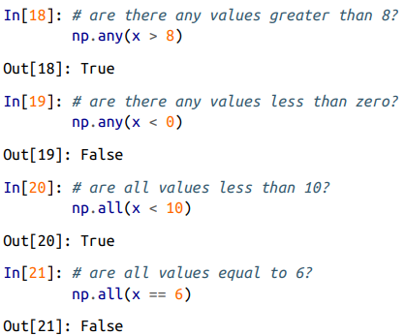
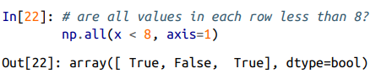
Comparisons, Masks, and Boolean Logic: Working with Boolean Arrays :
np.any() or np.all() is to quickly check whether any or all the values are true.
np.all() and np.any() can be used along particular axes as well. For example:
Here all the elements in the first and third rows are less than 8, while this is not the case for the second row. Numpy functions – aggregation will fail for Multidimarrays.

Slide 124
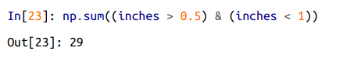
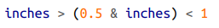
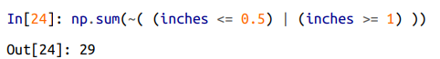
Comparisons, Masks, and Boolean Logic; Boolean operators
To know about all days with rain less than four inches and greater than one inch? accomplished through Python’s bitwise logic operators, &, |, ^, and ~.
Like standard arithmetic operators, NumPy overloads these as ufuncs that work element-wise on (usually Boolean) arrays. For example:
So we see that there are 29 days with rainfall between 0.5 and 1.0 inches.
Note: ( ) are important due to operator precedence rules and without (), the expression results in an error:
Same is achieved using the equivalence of A AND B and NOT (A OR B):
Combining comparison operators and Boolean operators on arrays can lead to a wide range of efficient logical operations.

Slide 125

Comparisons, Masks, and Boolean Logic :Boolean operators
The following table summarizes the bitwise Boolean operators and their equivalent ufuncs:

Slide 126

Comparisons, Masks, and Boolean Logic: Boolean operators
Using these tools, answer the types of questions on weather data.
Examples: can compute when combining masking with aggregations:

Slide 127



Comparisons, Masks, and Boolean Logic: Boolean Arrays as Masks
A more powerful pattern is to use Boolean arrays as masks, to select particular subsets of the data themselves.
Suppose want an array of all values in the array that are less than, 5: A Boolean array for this condition easily
Use indexing to select these values from the array and known as a masking operation,
Output is a 1D array filled with all the values that meet this condition and In other words, all the values in positions at which the mask array is True.

Slide 128

Comparisons, Masks, and Boolean Logic: Boolean Arrays as Masks
For example: compute some relevant statistics on Seattle rain data:
By combining Boolean operations, masking operations, and aggregates, we can very quickly answer these sorts of questions for any dataset.

Slide 129

Comparisons, Masks, and Boolean Logic: Boolean Arrays as Masks
Using the Keywords and/or Versus the Operators &/|: One common point of confusion is the difference between the keywords(and, or) and the operators(&, | ).
The difference is: (and, or) keywords gauge the truth or falsehood of entire object, while (&, |) operators refer to bits within each object.
When the keyword is used, it’s equivalent to asking Python to treat the object as a single Boolean entity. In Python, all nonzero integers will evaluate as True. Thus:
When operators on integers, the expression operates on the bits of the element, and applying the keywords to the individual bits make up the number:

Slide 130


Comparisons, Masks, and Boolean Logic: Boolean Arrays as Masks
Notice that the corresponding bits of the binary representation are compared in order to yield the result.
When have an array of Boolean values in NumPy, it will be considered as string of bits where 1 = True and 0 = False, and the result of & and | operates in a similar manner as before.

Slide 131


Comparisons, Masks, and Boolean Logic: Boolean Arrays as Masks
Using or keyword on these arrays will try to evaluate the truth or falsehood of the entire array object, which is not a well-defined value:
Similarly, when doing a Boolean expression on a given array, should use | or & rather than or or and:
Trying to evaluate the truth or falsehood of the entire array will give the same ValueError we saw previously

Slide 132
Thank You

